Slide 1
IRREGULAR VERBS
As you already know, past verbs add “–ed” at the end of the verb.
For example:
But, as it happens in Spanish, there are IRREGULAR VERBS you must memorise.
En inglés aprendemos los verbos irregulares en tres columnas; el presente, el pasado simple y el participio (verbos terminados en –ado/-ido como acabado o dormido) que se usará en los verbos compuestos; “he coloreado de rojo” = “I have coloured it in red”. En el caso de los verbos regulares, el participio es igual que el pasado. Sin embargo en los irregularies no siempre es así: “ He escrito un libro” = “I have written a book”.
PRESENT | PAST
Colour | Coloured
Observa estas listas de verbos irregulares que te he preparado. Están ordenados según el parecido en su transformación. Así te será más fácil aprenderos. Verás señalados y traducidos los más importantes. Toma nota de ellos en tu cuaderno.

Slide 2
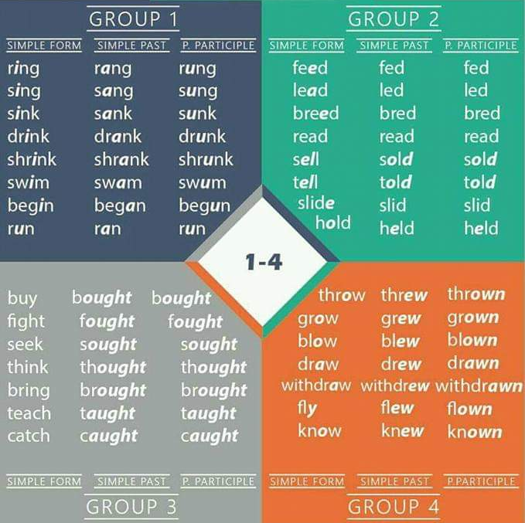
Cantar
Beber
Leer
Vender
Nadar
Contar
Empezar
Correr
Sostener
Comprar
Lanzar
Pelear
Crecer
Pensar
Dibujar
Traer
Enseñar
Enseñar
Saber

Slide 3
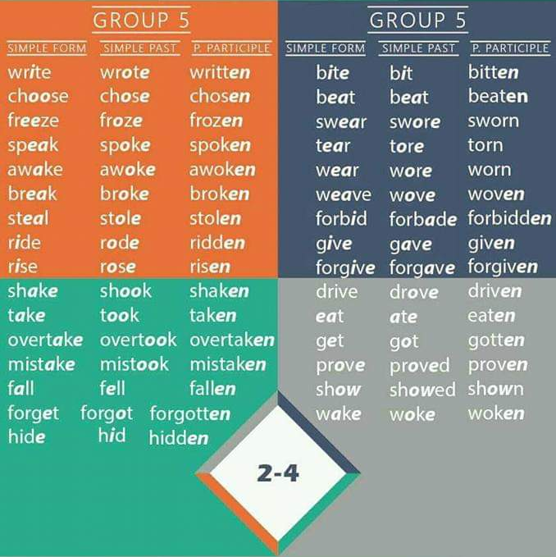
Escribir
Escoger
Congelar
Hablar
Llevar puesto
Romper
Montar (bici/ caballo)
Dar
Conducir
Tomar/
coger
Comer
Conseguir
Caer
Olvidar
Despertar

Slide 4
Golpear
Abandonar una actividad/
salir
Estar de pie
Permitir
Sentarse
Ganar
Cerrar
Hacer (fabricar)
Cortar
Pagar
Poner
Costar
Decir
Encontrar

Slide 5
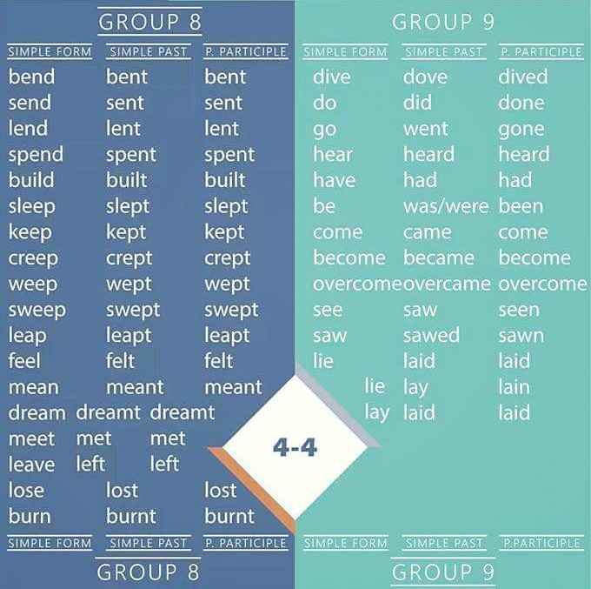
Enviar
Hacer
Gastar tiempo/ dinero
Ir
Oír
Construir
Tener
Dormir
Ser/estar
Venir
Llegar a ser
Ver
Sentir
Soñar
Quedar/ reunir
Salir
Perder

Slide 6
UNIT REVITION
Complete the chart. Then, correct yourself.
PRESENT | PAST | PAST PARTICIPLE
 |  | Bought
See
 | Did
Write
 |  | Drawn
 | Cut
Build
 | Flew
Have
 |  | Thought
 | Read
Come
 |  | Gone

Slide 7
UNIT REVITION
Complete the chart. Then, correct yourself.
PRESENT | PAST | PAST PARTICIPLE
Buy | Bought | Bought
See | Saw | Seen
Do | Did | Done
Write | Wrote | Written
Draw | Drew | Drawn
Cut | Cut | Cut
Build | Built | Built
Fly | Flew | Flown
Have | Had | Had
Think | Thought | Thought
Read | Read | Read
Come | Came | Come
Go | Went | Gone
Don’t look until you finish. Are you ready?

Slide 8
UNIT REVITION.
Now, correct yourself.
Complete the chart. Then, correct yourself.
PRESENT | PAST | PAST PARTICIPLE
Buy | Bought | Bought
See | Saw | Seen
Do | Did | Done
Write | Wrote | Written
Draw | Drew | Drawn
Cut | Cut | Cut
Build | Built | Built
Fly | Flew | Flown
Have | Had | Had
Think | Thought | Thought
Read | Read | Read
Come | Came | Come
Go | Went | Gone

